Slide 1


Local Arts Agency
Board Member Orientation

Slide 2




What Is a Local Arts Agency?
Local arts agencies promote and support their county's arts assets as essential to economic development while enhancing quality of life for residents.
Local arts agencies serve as economic drivers, preserving, developing, and growing the arts through financial support and guidance to emerging and established arts organizations and artists.
Local arts agencies provide their communities with access to experiences across the spectrum of literary, visual, performing, traditional, and multidisciplinary arts.

Slide 3
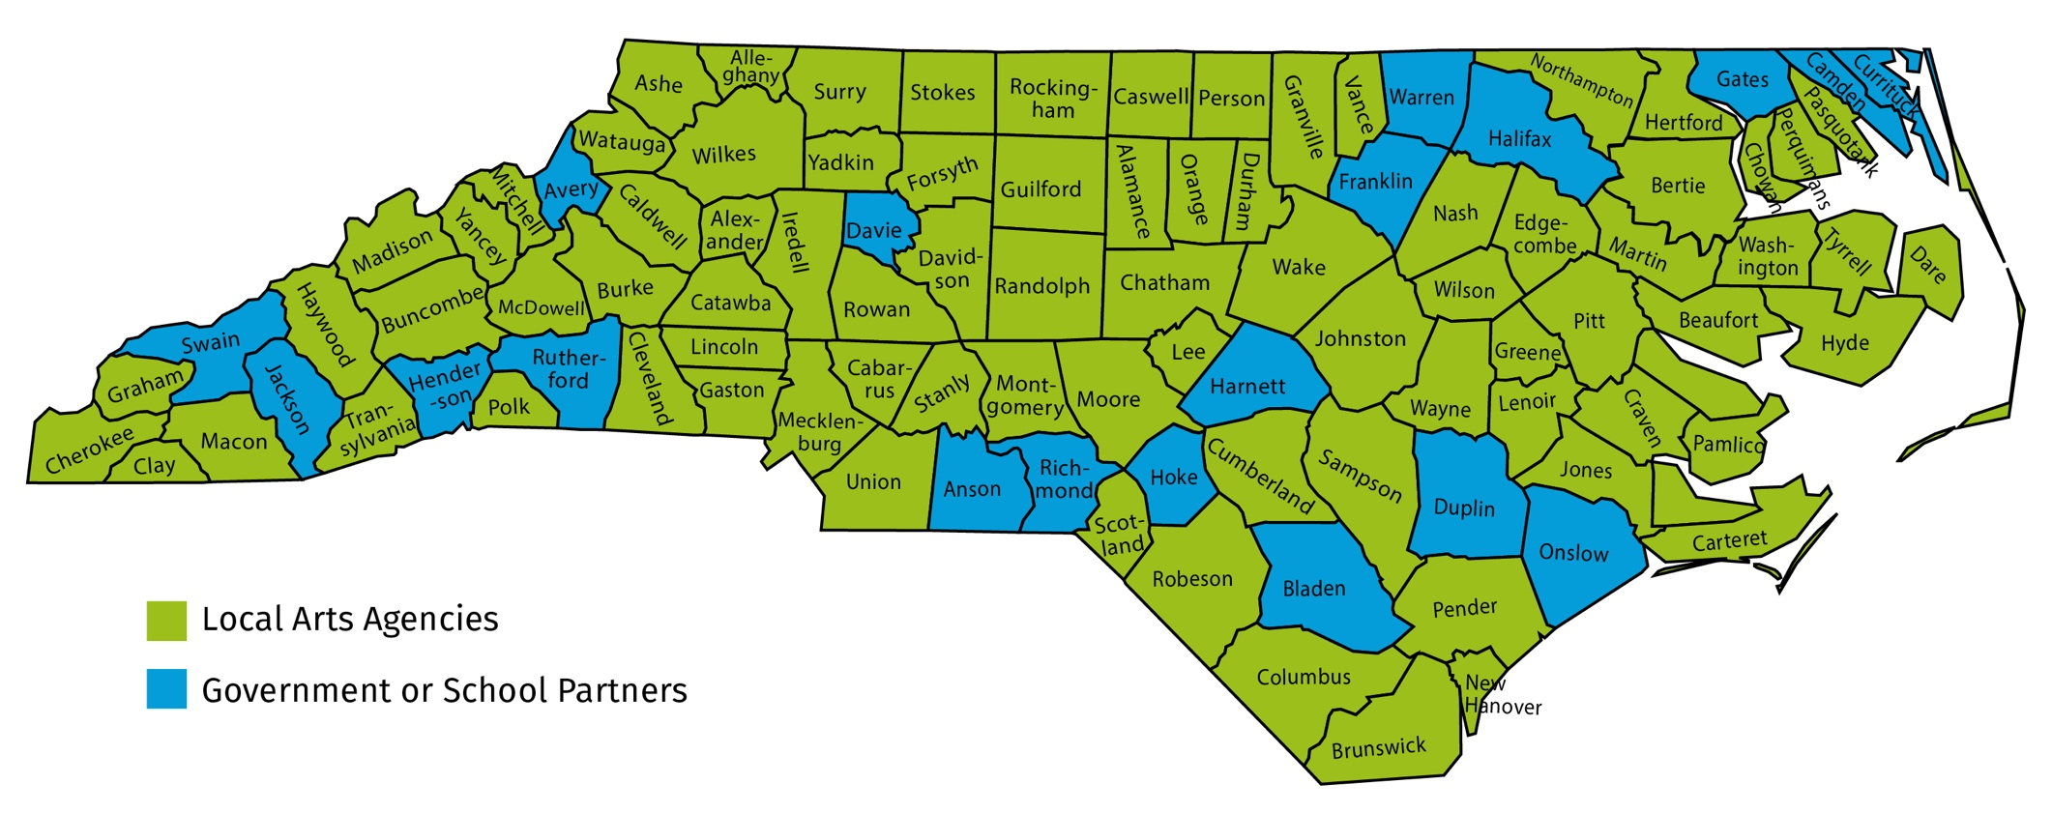
North Carolina’s Local Arts Agencies

Slide 4
Grassroots Network Accomplishments
Annual investments in artists, arts organizations, and
communities across the state
$4M+ in
artists
$2M+ in arts organizations
$1M+ in community orgs
The network invests more than $4 million annually in support of artists.
The network invests more than $2 million to support arts organizations.
The network invests more
than $1 million annually to
support community
organizations’
arts projects and events.

Slide 5
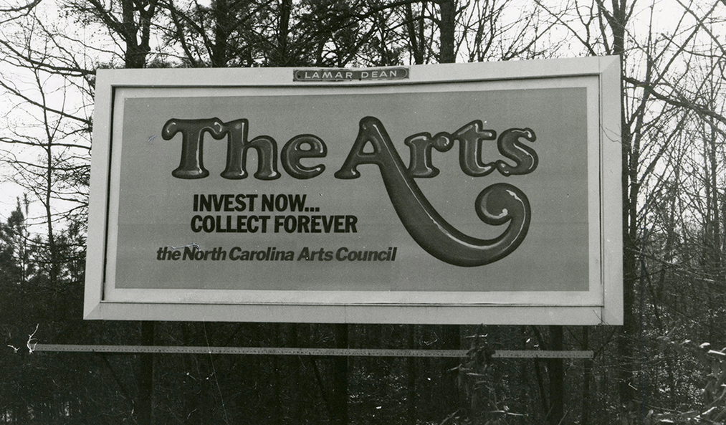
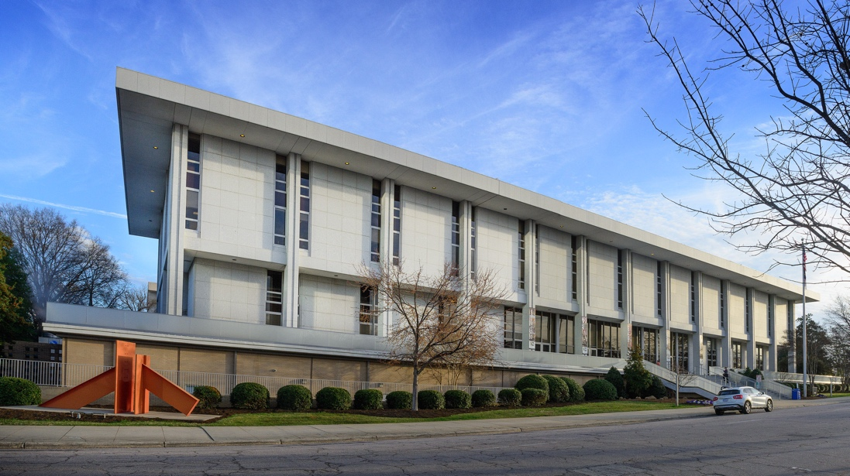
NC Arts Council’s Role in the Network
An old North Carolina Arts Council billboard
Grassroots Arts Program grant investment
Technical assistance and tools for staff and board of directors
Host regional convenings
Accreditation to ensure partner standards
N.C. Department of Natural & Cultural Resources

Slide 6

Collective Strength of the Network
Strong board leadership at every local arts agency is critical to strength of the network.
Local partnerships with government and business leaders is fundamental to success.

Slide 7
Board Responsibilities

Slide 8

Resource Development
Board Responsibilities
Develop fundraising plan alongside staff
Actively engage in fundraising efforts (e.g., via a fundraising committee)
Expand contributor base through personal contacts
Make personal contribution annually.

Slide 9

Financial Oversight and Planning
Board Responsibilities
Assist in developing annual budget.
Ensure that fiscal controls and financial policies are in place.
Review financial statements monthly
Allocate resources for the sustainability of the organization (e.g., reserves, endowment, or investment fund)

Slide 10

Organizational Planning
Board Responsibilities
Ensure organization is guided by a strategic plan
Assist in implementing and monitoring strategic plan
Assist in communicating plan to funders, friends, and the public

Slide 11

Legal and Ethical Integrity
Board Responsibilities
Model ethical and responsible leadership
Sign a conflict-of-interest form annually
Monitor legal compliance to maintain nonprofit status
Ensure organization operates with financial transparency

Slide 12

Recruitment, Engagement and Assessment
Board Responsibilities
Adhere to board rotation policies outlined in bylaws
Conduct annual board assessment to evaluate effectiveness
Strategically recruit new board members for their skills, knowledge, and experience
Work with staff to conduct annual board orientation

Slide 13

Manage Executive Director
Board Responsibilities
Select and orient executive director
Ensure the executive director position has the resources to meet organizational goals
Conduct annual review of executive director
Support professional development opportunities

Slide 14

Advocacy
Board Responsibilities
Enhance the organization's public standing through personal networks
Develop a strategy with staff for regular connection with local elected officials
Join Arts North Carolina for statewide advocacy calls to action

Slide 15
Board Member Advocacy

Slide 16
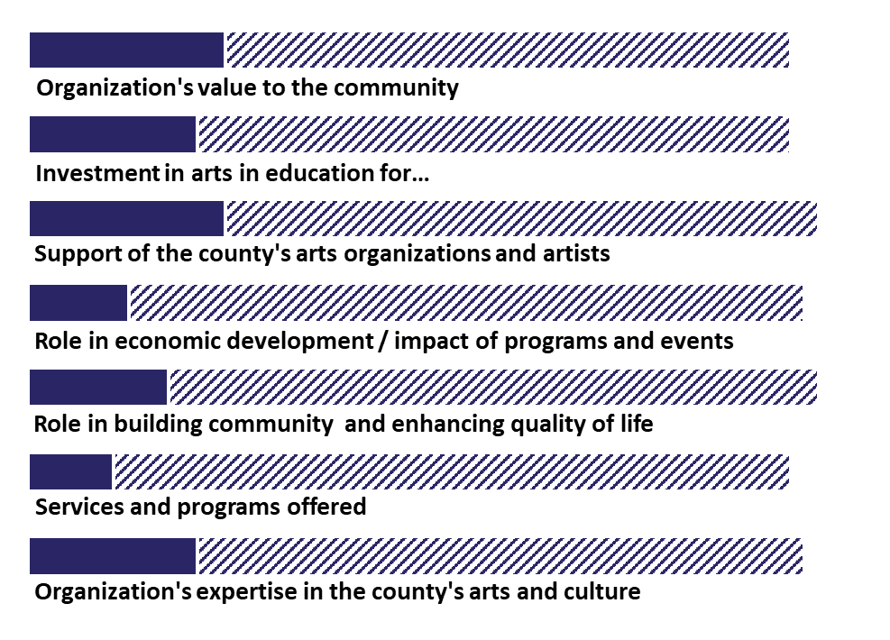
Strategies #1
Board Member Advocacy
Local arts agency directors rated their local leaders' understanding of their arts council's role in the county.
Board members can educate local leaders about the value of your local arts agency's role to the community.
Full
Some to minimal
None or not sure

Slide 17
Strategies #2
Board Member Advocacy
More than 60 percent of local art agencies staff and board attend at least one meeting per year of elected officials, i.e., city council or county commissioner meeting
Board members can engage with elected officials year-round to develop stronger relationships.

Slide 18
Strategies #3
Board Member Advocacy
Frequency of individual meetings with city and county elected officials by local arts agency staff and board
Make time for intentional, individual meetings with your city and county elected officials to build meaningful personal connections.

Slide 19
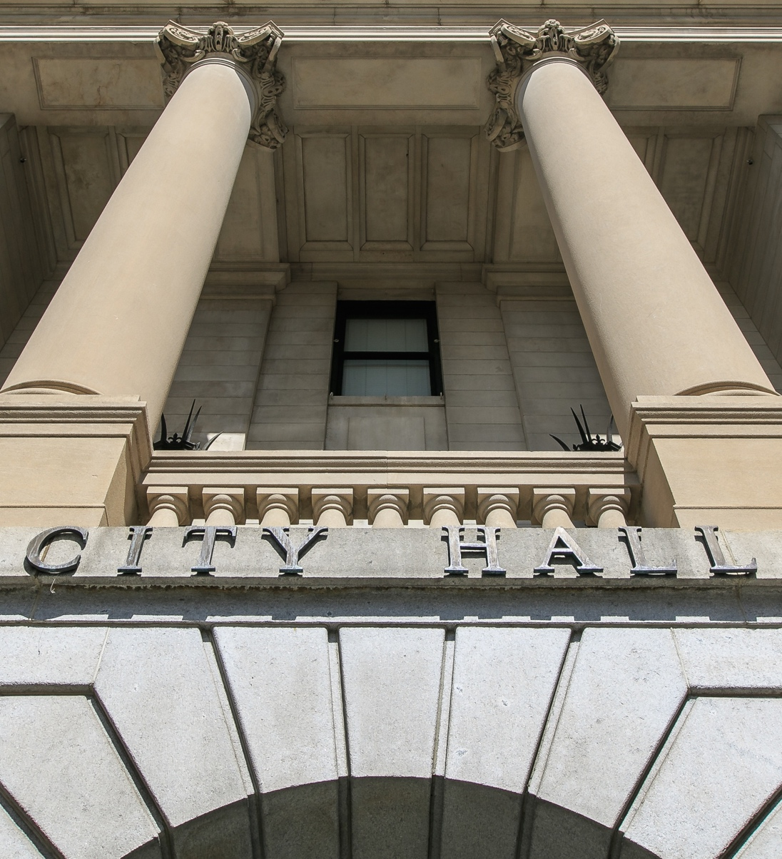
Making the Case For
Local Government Support
Board Member Advocacy
Facilitates accessibility and affordability
Reaches all demographics
Focuses on public benefits
Guided by strategic plans
Embodies transparency and accountability
Leverages additional investment
Helps government achieve public policy goals

Slide 20



Thank you
@NCArts
@NCArtsCouncil
@NCArts
North Carolina Arts Council

