Slide 1


Local Arts Agency Accreditation

Slide 2



Grassroots Arts Program partnership
Image Courtesy of Arts Council of Wilson
Image courtesy of Toe River Arts Council
Accreditation
Stamp of approval
The North Carolina Arts Council affirms its partnership with local arts agency partners across the state through an accreditation process that occurs on a four-year cycle.
Assuring the public, local governments and funders that your organization possess the capability and quality to manage state funds for the county.

Slide 3

Accreditation process
Conducted by a panel of arts professionals, the process provides feedback and recommendations for strengthening local arts agencies (LAA) in the North Carolina Arts Council network.
The accreditation evaluates the organization’s management, financial stability, adherence to best practices as a nonprofit organization and an LAA, impact in the community served, and role in sustaining and developing the arts in the county they represent.

Slide 4

Accreditation components
Document and materials review (due January 15th)
Site visit by NCAC staff
Virtual interviews with NCAC staff, panelists and LAA's executive staff and executive board members (March/April)
Panel meeting for final review and recommendations (May/June)

Slide 5
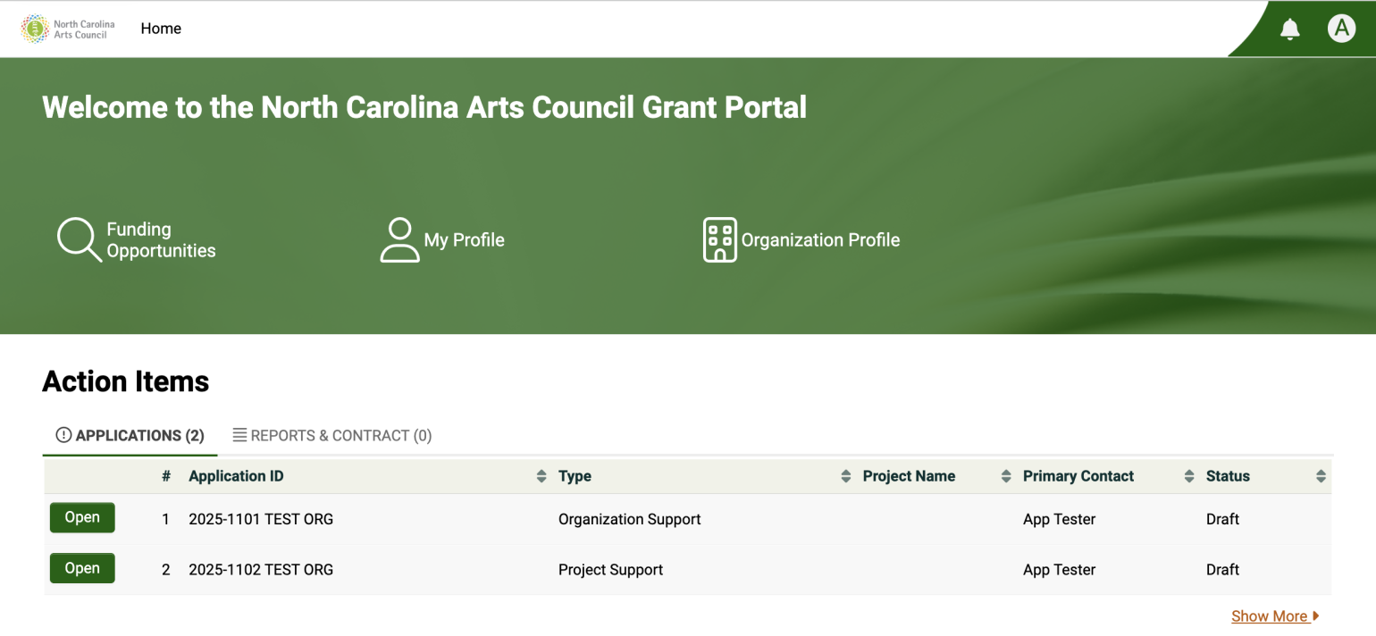
Navigating OPAL

Slide 6
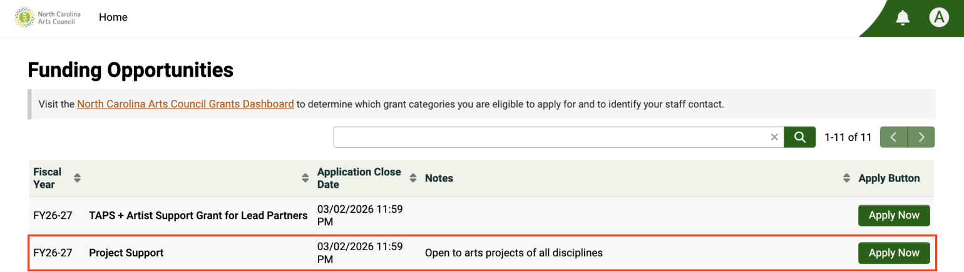
Select “Apply Now” on Grassroots Arts Program Partner Accreditation
Navigating OPAL
FY27-28 Grassroots Arts Program Partner Accreditation 1/15/2027 11:59 PM

Slide 7
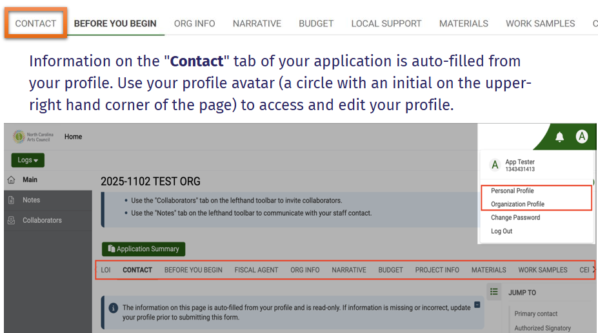
Profile information

Slide 8
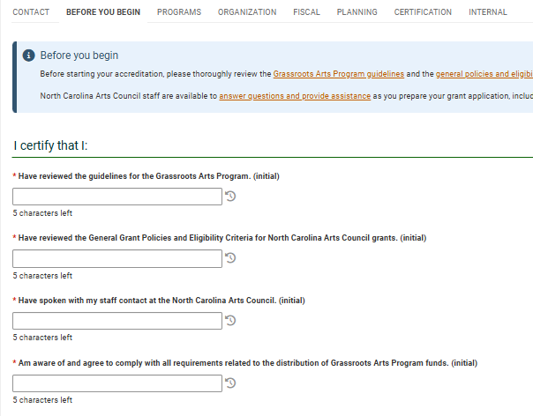
Before you begin

Slide 9
Programs and services
Narrative
Describe the core functions of your organization and the impact they have within your county.
  Uploads:
    Website link (required)
    Examples of newsletter or email updates to constituents (required)
    Accessibility plan or services (required)
    Marketing and Social Media plan
    Grantmaking Policies and Guidelines
    Annual report
Additional Context: Narrative box to provide any relevant updates or contextual information for uploads in this section.

Slide 10
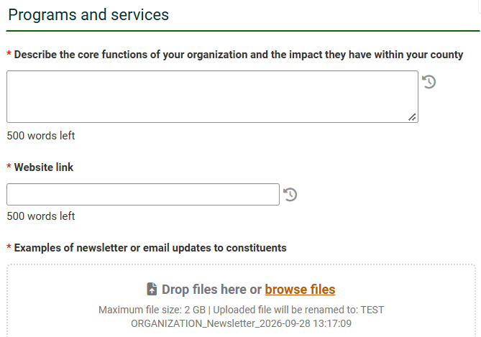
OPAL: Programs and services

Slide 11
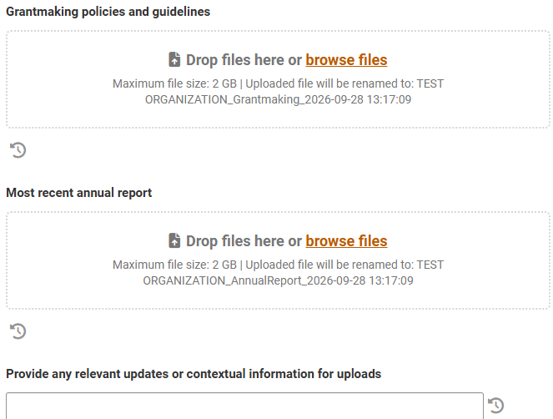
OPAL: Programs and services, continued

Slide 12
Organization management
Narrative
Describe your staffing structure, including the tenure and experience of senior staff. Describe how the staff is evaluated annually.
  Uploads:
    Board of Directors bylaws (required)
    Board meeting minutes from the past fiscal year (required)
    Board roster including terms of service and professional affiliations (required)
    Board orientation materials (required)
    Operations policies (required)
    Personnel policies, if applicable
    Organizational chart, if applicable
Additional Context: Narrative box to provide any relevant updates or contextual information for uploads in this section.

Slide 13
Fiscal stability
Narrative
Describe your organization’s overall financial condition including any debts, reserves, investments, or endowments.
  Uploads:
    Financial policies and procedures (required)
    Financial statement for last completed fiscal year (required)
    Financial statement for current fiscal year, with year-to-date column (required)
Additional Context: Narrative box to provide any relevant updates or contextual information for uploads in this section.

Slide 14
Planning and development
Uploads:
  Current strategic plan (required)
  Development and fundraising plan (required)
  List of major funders, grantors, and foundation support (required)
  List of community collaborators
  Engagement or communication plan with elected officials
Additional Context: Narrative box to provide any relevant updates or contextual information for uploads in this section.

Slide 15
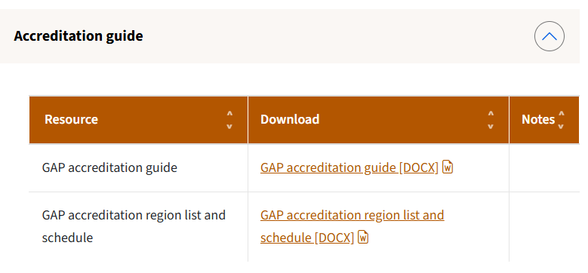
Accreditation resources
Local Arts Agency Resources Page on NC Arts Council website:
www.ncarts.org/local-arts-agency-resources

Slide 16
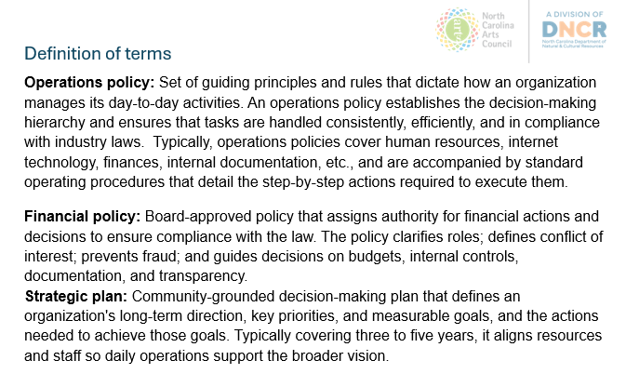
Accreditation guide

Slide 17
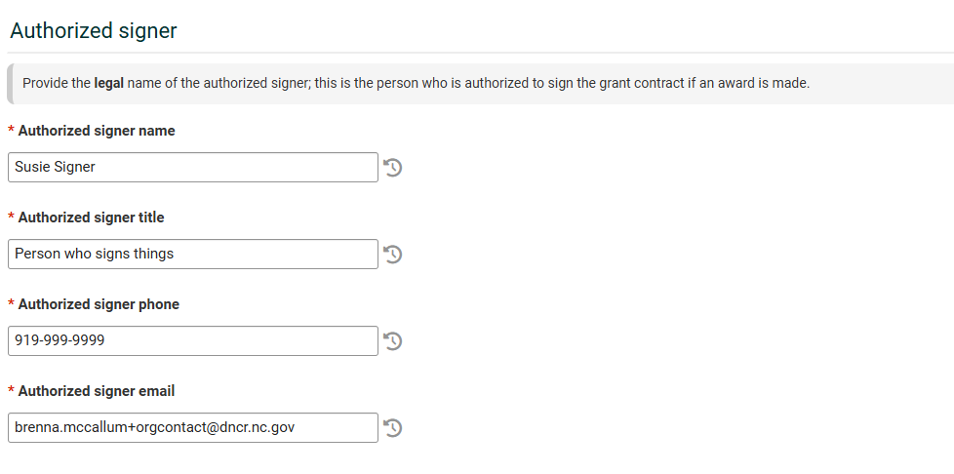
Next steps
Make sure your Authorized Signer is correct in your Organization Profile in OPAL

Slide 18
What’s next?
OPAL accreditation platform will open on Monday, October 19, 2026.
  NC Arts Council staff will send our contacts a notification with instructions when it is live
Begin gathering required documentation now!
Accreditation documentation must be received in OPAL by Friday, January 15, 2027
Virtual interviews will include executive board members, so everyone should be involved and informed.

Slide 19



Thank you
@NCArts
@NCArtsCouncil
@NCArts
Janelle Wienke
Arts in Communities Western Regional Director
janelle.wienke@dncr.nc.gov
(919) 814-6506
Sam Gerweck
Arts in Communities Eastern Regional Director
sam.gerweck@dncr.nc.gov
(919) 814-6523

