Slide 1
Grassroots ARPA Subgranting Workshop
<Your County Arts Council Name> <Misc. Info (date, location, etc.)>

Slide 2
Grassroots Arts Program Federal Funding (ARPA)
ARPA Funds
North Carolina legislature has designated $10 million in American Rescue Plan Act (ARPA) funds to be distributed through the Grassroots network over two years with no match required.
ARPA funds will be distributed in two installments:
$5 million in FY 2022-23
$5 million in FY 2023-24
FY22-23
FY23-24

Slide 3
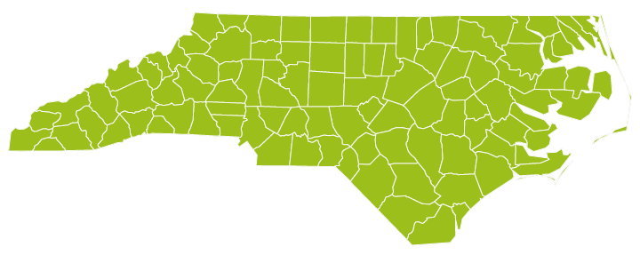
Grassroots Arts Program ARPA
The Grassroots Arts Program is a partnership between local arts council and the North Carolina Arts Council. All 100 counties in N.C. receive ARPA funds on a straight per capita basis.

Slide 4
Grassroots Arts Program ARPA
In counties with populations of 50,000 or more, the local arts council must distribute 50 percent of the Grassroots Arts ARPA funds to local arts organizations through a competitive grant process.

Slide 5
Grassroots Arts Program ARPA
Grassroots Partners are required to assign a percentage of the funds to support BIPOC* arts organizations and/or multicultural programming.
*Black, Indigenous people of color
Notes:
Infographic??? Checks? Piles of money? Percent sign on a NC shape, *NC shape lots of people (non political colors – blue and green)

Slide 6
Strategy for ARPA funds
BUILD
sustainability of your arts organization or art programs (beyond projects, investing in operations, and staff).
DEVELOP
new relationships with BIPOC* arts organizations and artists.
INVEST
in capacity building for your organization (shared trainings, specific capacity-building tailored to your organizations, strategic planning).
*Black, indigenous, and people of color.

Slide 7
Eligibility for application
While nonprofit status is preferred, organizations that have been in operation for at least one year may apply.
All organizations must reside and carry out projects in <your county name>.
Projects must take place between July 1, 2023 and June 15, 2024.
Only complete applications received by the due date will be considered.

Slide 8
Examples of ARPA fund investments

Slide 9
Capacity building
Consultants for strategic-planning
Developing a fundraising plan
Professional marketing plan
Website refresh
Program evaluation
Board training
Staff training or professional development
Diversity, equity, accessibility, and inclusion training.

Slide 10
Sustainability
Hiring staff or contractors
Equipment purchases or upgrades
Small capital expenditures up to $25,000 (total in two years)
Full financial audit
Arts & Economic Prosperity (AEP) study participation

Slide 11
Expanding relationships with BIPOC* artists
Developing new partnerships, programming, and outreach, including:
Small-scale creative placemaking projects with BIPOC* artists
Piloting new events or programs beyond Black History Month or Native American Heritage Month, etc.
*Black, indigenous, and people of color.

Slide 12
Application

Slide 13
How to apply
Start a conversation with your local arts council
Schedule a meeting to discuss your organizations recent history
Prepare a list of organizational needs and intended goals
Discuss the possibility of shared trainings with other organizations in your county
Applications are available at <enter URL>

Slide 14
Application form

Slide 15
Evaluation
How applications are evaluated

Slide 16
Subgrant Panels
Panel of community members review each grant
Panelists base funding decisions on the quality of the grant application, not on their relationship with, or knowledge of, the organization
Panelists review overall completeness of the grant and score applications on specific criteria

Slide 17
Criteria
Investment will address specific organizational needs and goals
Identification of consultants or community partners to implement project
Ability to communicate specific outcomes or goals for the grant
Ability to plan and implement
Stability and fiscal responsibility of the organization

Slide 18
If you get funded…
Your organization will enter into a contractual agreement with <Your County Arts Council Name Here>.
Submittal of No Overdue Tax Debts Form
Your organization is required to complete a final report by June 30 with:
Audience numbers
Audience demographics
Demonstrate use of N.C. Arts Council logo and credit line on promotional materials

Slide 19
If you get funded…cont.
Late final reports = no funding next grant cycle.
Keep local arts council updated on the progress of your program. If something changes and you can’t use all the funds, your local arts council must know by April. They will need to roll the funds into one of their programs.

Slide 20
Questions?
If you need help with your application, or have specific questions, contact:
<Contact Name>
<Contact Information>

