Slide 1
Grassroots Arts Program Subgranting Workshop
<Your County Arts Council Name>
<Misc. Info (date, location, etc.)>

Slide 2
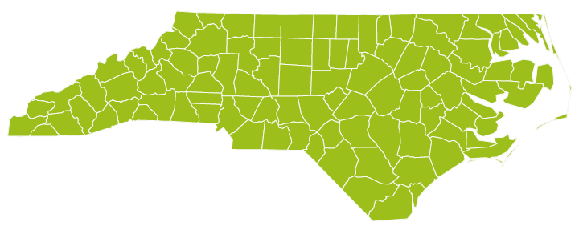
Grassroots Arts Program
The Grassroots Arts program is a partnership between local arts councils and the North Carolina Arts Council. All 100 counties in N.C. receive program funds.

Slide 3
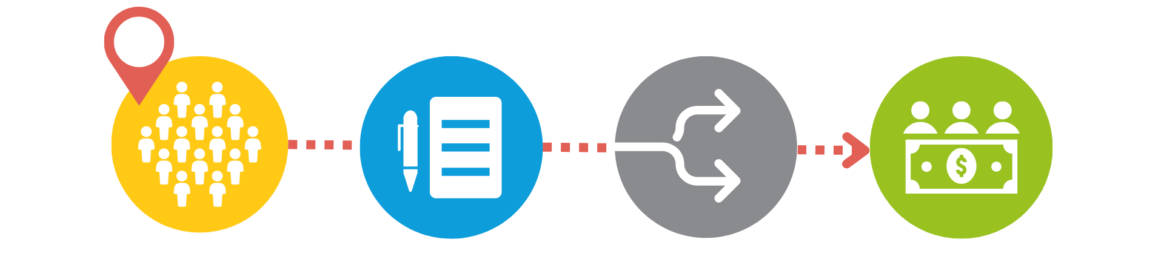
Grassroots Arts Program
In counties with populations of 50,000 or more, the local arts council will distribute
50 percent of the Grassroots funds to local arts organizations through a competitive grant process.

Slide 4
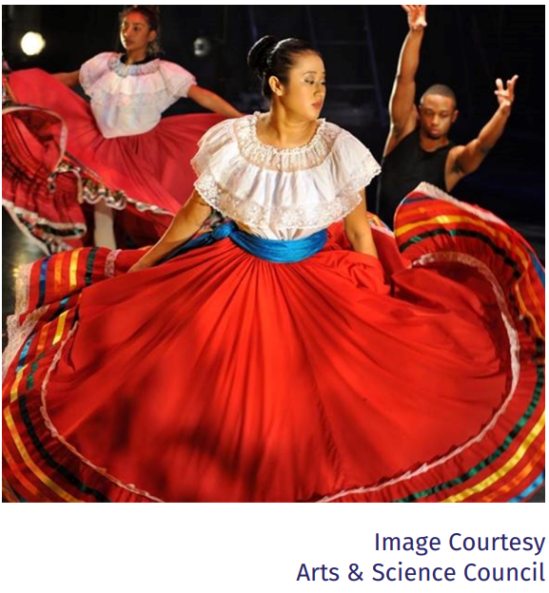
Racial and Cultural Diversity
Grassroots partners are required to spend a percentage of their grant on programing that reflects African America, Asian American, Latino, and Native American cultures.
The minimum amount is included on the County Allotment chart annually
Priority may be given to subgrant applicants that meet this requirement.

Slide 5
Racial and Cultural Diversity
The requirement can be met in several ways:
Grassroots Partner can hire artists or ensembles of color to conduct arts programs.
Grassroots Partner can award subgrants to multicultural organizations. The organization does not have to be an arts organization, but the funds must be used for arts programming.
The Grassroots partners can award subgrants to other organizations to hire artists or ensembles of color to conduct arts programs.

Slide 6

Eligibility for Application
While nonprofit status is preferred, organizations that have been in operation for a least one year may apply.
All organizations must reside and carry out projects in <your county name>.
Projects must take place between July 1, <fiscal year> and June 15, <fiscal year>.
Only complete applications received by the due date will be considered.

Slide 7

Subgrant Requirements
Matching Requirement
  One – to – one cash match
N.C. Arts Council and Local Arts Council Recognition
  Logos and credit line according to guidelines
Reporting Requirements
  Final Report to <your arts council name>
  Thank you letters to state legislators
  No Overdue Tax Form

Slide 8
What the Grant Will Fund
Program expenses for projects of high artistic merit including artist fees and travel, space rental, marketing, advertising, costumes, sets, props, music and equipment rental.
Limited operating expenses for arts organizations only. Organizations receiving N.C. Arts Council Sustaining Support funding are not eligible to receive GAP subgrant funding.

Slide 9
What the Grant Will NOT Fund
Individual applicants
Art supplies
Fundraising events or expenses
Food or beverages
Prizes, tuition or scholarships
School band activities or equipment
Purchase of artwork
Internal programs for schools, colleges, universities, or libraries
Programs with religious content

Slide 10
The Application
Organizational Information & Project Description

Slide 11
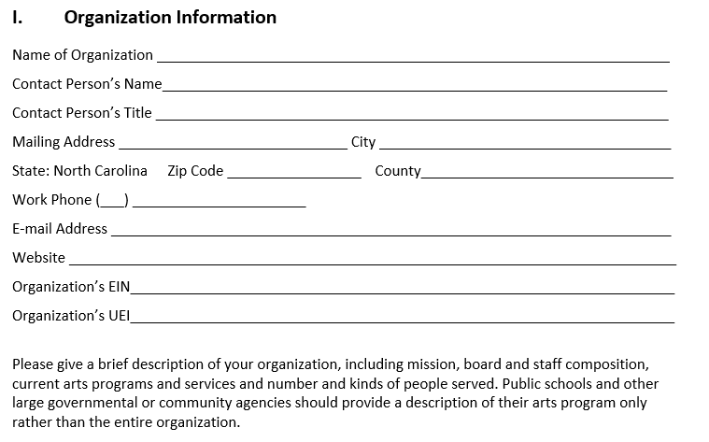

Slide 12
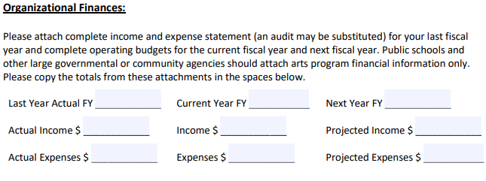
Remember to include an attached financial statement from your most recent completed FY
<fiscal year funding will be spent>
<last completed fiscal year>
<current fiscal year>

Slide 13
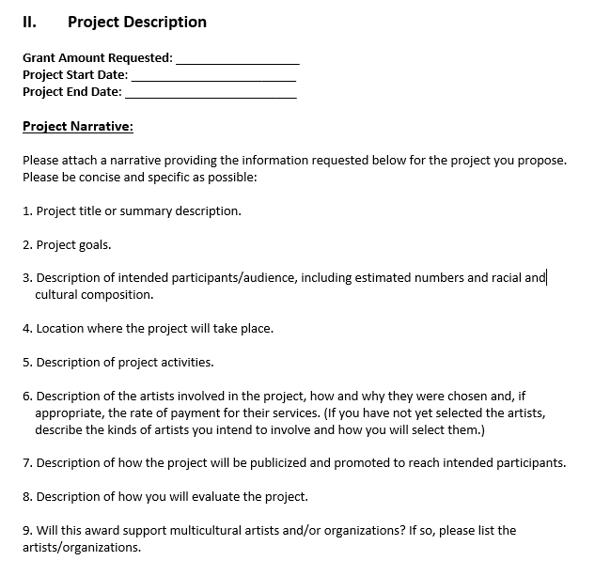

Slide 14
Audience and Location
Description of intended audience or participants:
  Be specific: “We expect the community participation to be 200 adults and 300 middle-school-aged children, with approximately 64% Caucasian and 46% to be African American.”
Location of project

Slide 15
Project Description
Project title or summary description
    Why should the project be funded?
    Include any community partnerships
Project Goals
    What will participants learn or gain from the arts experience?
    How will the project impact the community?

Slide 16
Activities and Artists
Description of Project activities
    For example: Each art camp student will engage in a rotating schedule of visual and performing arts classes. This includes 20 hours a week of instruction, with at least 10 hours devoted to sculpture, drawing and painting and 10 hours to dance, theatre and musical instruction.
Description of the artists involved
    How they were chosen (include credentials in narrative)
    Rate of Payment
    If the artists have not been chosen yet, describe the process for choosing artists.

Slide 17
Marketing and Evaluation
How the project will be publicized and promoted
    Specific outreach to include intended audience?
    Community Partner’s newsletters?
    Press releases, website, advertising, PSAs
How will the project be evaluated?
    Surveys? Participant feedback?
    Revenue?
    Community Impact?

Slide 18
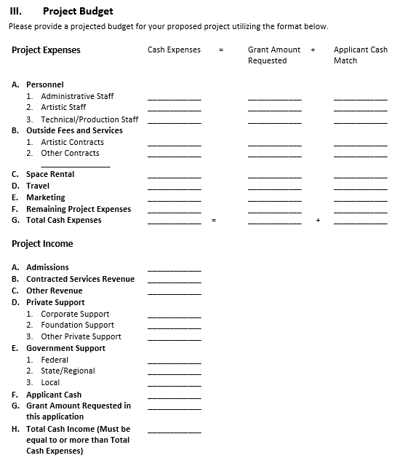

Slide 19
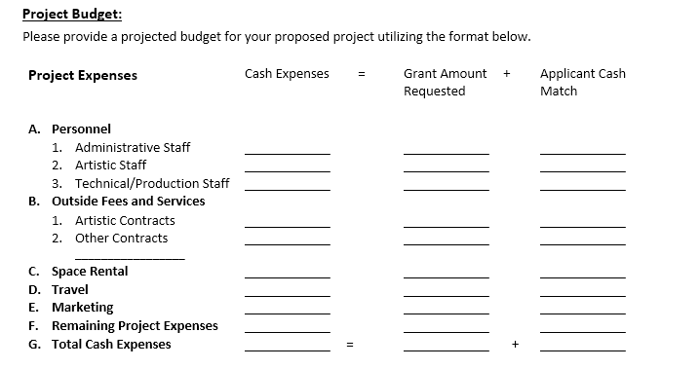

Slide 20
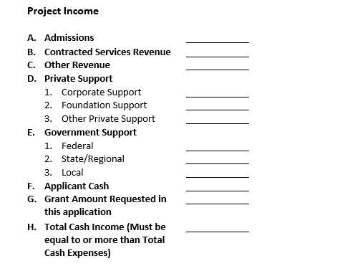

Slide 21
Evaluation
How Applications are Evaluated

Slide 22

Subgrant Panels
Panel of community members review each grant
Panelists base funding decisions on the quality of the grant application, not on their relationship with, or knowledge of the organization
Panelists review overall completeness of the grant and score applications on specific criteria

Slide 23

Criteria
Artistic quality of the proposed project
Community impact of project or program
Ability to plan and implement project
Stability and fiscal responsibility of the organization

Slide 24

The first priority is to provide program or operating support to qualified arts organizations (where they exist), such as theaters, symphonies, galleries, art guilds, choral societies, dance companies, folk arts societies, writer’s groups, and arts festivals. Subgrants of Grassroots funds may not be awarded to arts organizations that already receive operating support directly from the N.C. Arts Council.
The second priority funds is to support arts learning and arts-in-education programs conducted by qualified artists. These can be artist residencies in schools, after-school programs, summer camps, or adult arts learning classes. Grassroots funds may not be used for activities associated with a school’s internal arts programs such as in-school student performances, the purchase of supplies, or student art competitions and publications.
The third priority is to support other community, civic, and municipal organizations that provide high-quality experiences for the greater community. These programs must be conducted by qualified artists.
Priorities for Funding

Slide 25
If you get funded…
Your organization will enter into a contractual agreement with < arts council name>
Submittal of No Overdue Tax Debts Form
Your organization will complete a final report by June 30 with:
    Audience numbers
    Audience demographics
Demonstrate use of N.C. Arts Council logo and credit line on promotional materials
Grant payments may be distributed in installments
Keep local arts council updated on the progress of your program. If something changes and you can’t use all the funds, your local arts council must know by April. They will need to roll the funds into one of their programs.
NOTE: Late final reports=no funding next grant cycle.

Slide 26
Questions?
If you need help with your application, or have specific questions, contact:
<Contact Name>
<Contact Information>

