Slide 1


Subgranting Workshop
Grassroots Arts Program

Slide 2
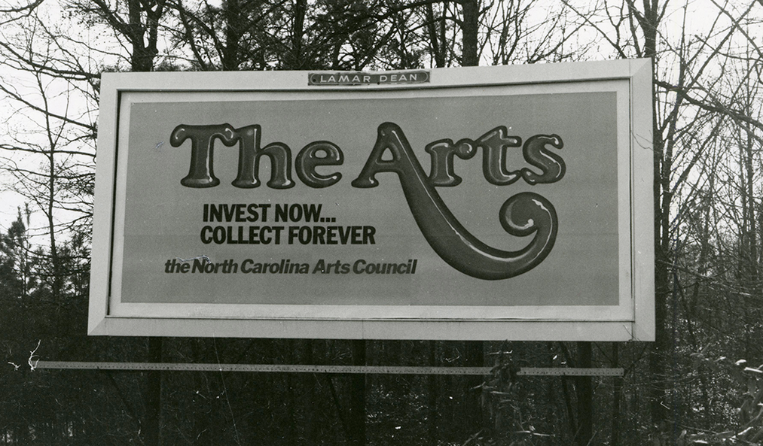

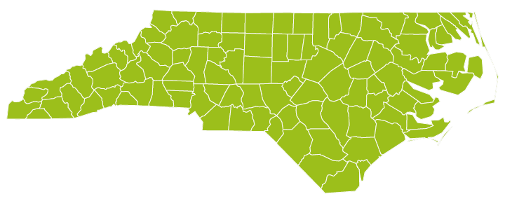
North Carolina Arts Council’s Grassroots Arts Program
An old North Carolina Arts Council billboard
The Grassroots Arts program is a partnership between local arts agencies and the North Carolina Arts Council. All 100 counties in N.C. receive program funds.
Map of North Carolina and its 100 counties

Slide 3
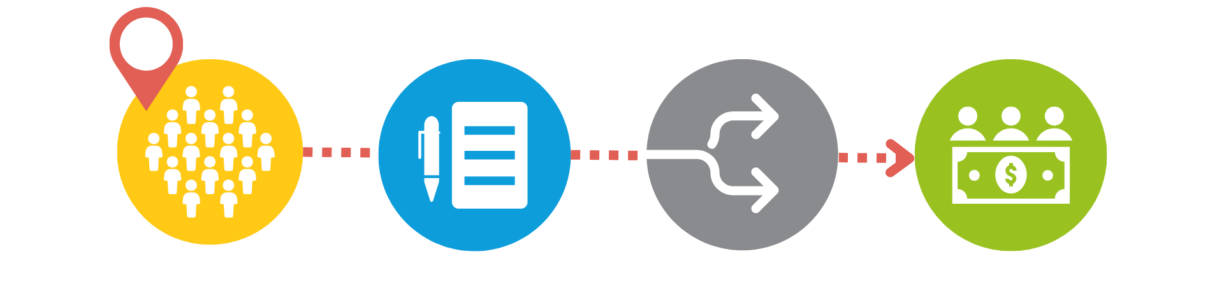
Grassroots Arts Program: Subgranting
In counties with populations of 50,000 or more, the local arts agency is required to distribute 50 percent of the Grassroots funds to local arts organizations through a competitive grant process.

Slide 4

Eligibility
Grassroots Subgrants
While nonprofit status is preferred, organizations that are nonprofit in nature, and in some cases, individuals are eligible to apply.
All organizations must reside and carry out projects in [your county name].
Projects must take place between July 1, [fiscal year] and June 30, [fiscal year].
Only complete applications received by the due date will be considered.

Slide 5
What the Subgrant WILL Fund
Program expenses for art projects, including artist fees and travel, space rental, marketing, advertising, costumes, sets, props, music and equipment rental.
Limited operating expenses for arts organizations only. Organizations receiving N.C. Arts Council Sustaining Support funding are not eligible to receive Grassroots funding.

Slide 6
What the Subgrant WILL NOT Fund
Fundraising events or expenses
Food or beverages
Prizes, tuition or scholarships
School band activities or equipment
Purchase of artwork
Internal programs for schools, colleges, universities, or libraries
Programs with religious content

Slide 7

Requirements
Grassroots Subgrants
Matching Funds
Subgrants require a 1:1 cash match
N.C. Arts Council and Local Arts Council Recognition
Logos and credit line according to guidelines
Reporting Requirements
Final Report to [Grassroots Partner name]
Notarized No Overdue Tax Form

Slide 8
The Application
Organizational Information & Project Description

Slide 9
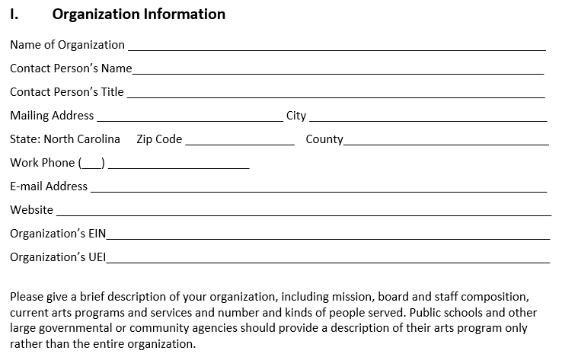
Organization information

Slide 10
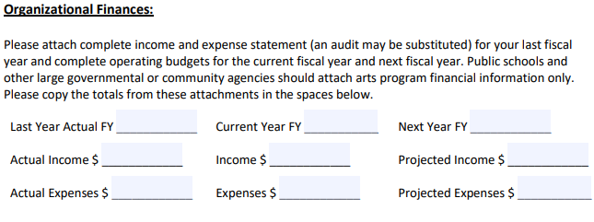
Organization finances
Remember to include an attached financial statement from your most recent completed fiscal year.
<fiscal year funding will be spent>
<last completed fiscal year>
<current fiscal year>

Slide 11
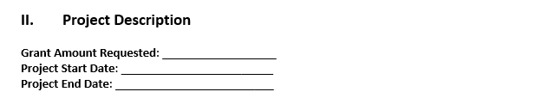
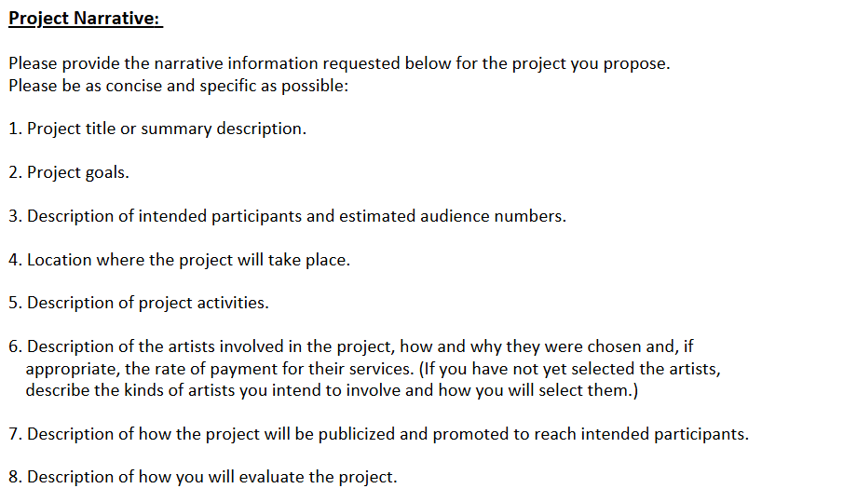
Project description: application screenshot

Slide 12
Project Description
Project title or summary description
Why should the project be funded?
Include any community partnerships
Project Goals
What will participants learn or gain from the arts experience?
How will the project impact the community?

Slide 13
Audience and Location
Description of intended audience or participants
Be specific: “We expect the community participation to be 200 adults and 300 middle-school-aged children, with approximately 64 percent Caucasian and 46 percent to be African American.”
Location of project
Addresses

Slide 14
Activities and Artists
Description of Project activities
For example: Each art camp student will engage in a rotating schedule of visual and performing arts classes. This includes 20 hours a week of instruction, with at least 10 hours devoted to sculpture, drawing and painting and 10 hours to dance, theatre and musical instruction.
Description of the artists involved
How they were chosen (include credentials in narrative)
Rate of payment
If the artists have not been chosen yet, describe the process for choosing artists.

Slide 15
Marketing and Evaluation
How the project will be publicized and promoted
Specific outreach to include intended audience?
Community Partner’s newsletters?
Press releases, website, advertising, PSAs
How will the project be evaluated?
Surveys? Participant feedback?
Revenue?
Community Impact?

Slide 16
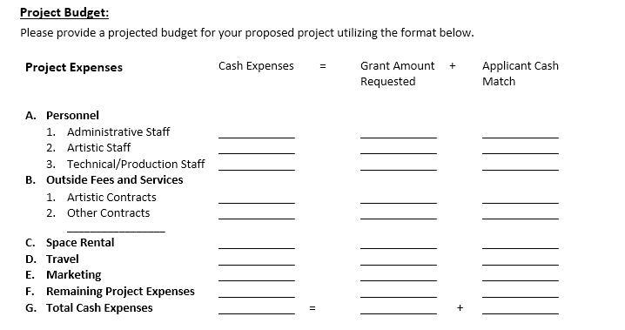
Project budget: application screenshot

Slide 17
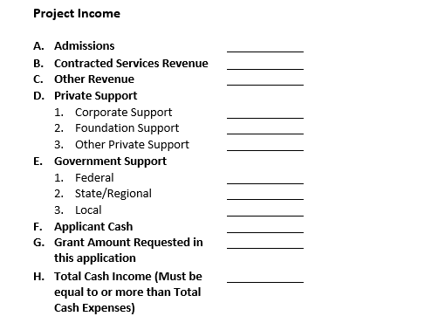
Project income: application screenshot

Slide 18
Evaluation
How Applications are Evaluated

Slide 19

Subgrant Panels
Evaluation
Panel of community members review each grant
Decisions are made on the quality of the grant application, not on their relationship with or knowledge of the organization
Panelists review overall completeness of the grant and score applications on specific criteria

Slide 20

Criteria
Evaluation
Artistic quality of the proposed project
Community impact of project or program
Ability to plan and implement project

Slide 21
Priorities for Funding
The first priority is to provide program or operating support to qualified arts organizations (where they exist), such as theaters, symphonies, galleries, art guilds, choral societies, dance companies, folk arts societies, writer’s groups, and arts festivals.
The second priority funds is to support arts learning and arts-in-education programs conducted by qualified artists. These can be artist residencies in schools, after-school programs, summer camps, or adult arts learning classes.
The third priority is to support other community and civic organizations that provide arts programs and experiences for the greater community. These programs must be conducted by qualified artists.

Slide 22
If You Get Funded
Your organization will enter into a contractual agreement with [Grassroots partner name]
Submit Notarized No Overdue Tax Debts Form
Your organization will complete a final report by June 30 with:
  Audience numbers
  Audience demographics
Demonstrate use of N.C. Arts Council logo and credit line on promotional materials
Grant payments may be distributed in installments
Keep local arts council updated on the progress of your program. If something changes and you can’t use all the funds, your local arts council must know by April.
NOTE: Late final reports=no funding next grant cycle.

Slide 23



Thank you
@NCArts
@NCArtsCouncil
@NCArts
If you need help with your application, or
have specific questions, contact:
[Contact Name]
[Contact Information]

