Slide 1
Artist Support Grant Application Workshop
For regions utilizing the GO Smart online application

Slide 2
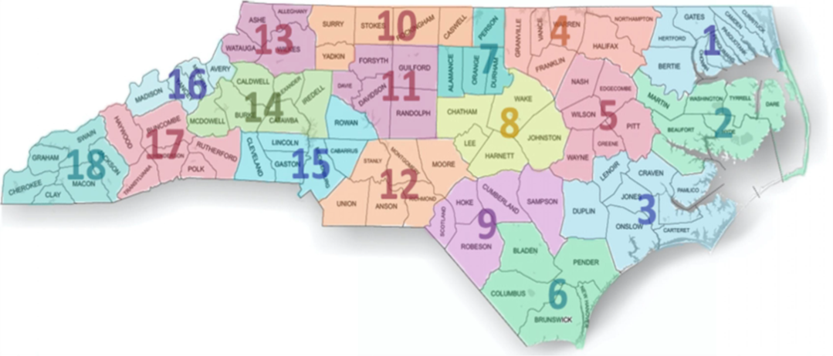
GO Smart application in Four Regions
Region 2: Beaufort, Dare, Hyde, Martin, Tyrrell and Washington
Region 4: Granville, Vance, Franklin, Warren, Halifax and Northampton
Region 10: Caswell, Rockingham, Stokes, Surry and Yadkin
Region 16: Avery, Madison, Mitchell and Yancey

Slide 3
North Carolina Arts Council’s Artist Support Grant
The Artist Support Grant provides direct support to individual artists for professional and artistic development, either to enhance their skills and abilities to create work, or to improve their business operations and capacity to bring the work to audiences.

Slide 4
Eligibility for application

Slide 5
Disciplines
The Artist Support Grant is intended to support a broad range of talented visual, performing, literary, and interdisciplinary artists.

Slide 6
Emerging and established artists
Eligible candidates may be either emerging or established artists. Applicants should demonstrate a commitment to spending a significant portion of their time on their work as artists.

Slide 7
Individuals and groups
Individuals and Artist Collectives Both individual artists and small, unincorporated groups of collaborating artists are eligible to apply.
All members of a collaborating team must be North Carolina residents, live in the region where they are applying, and meet the other eligibility requirements. Résumés documenting residence from all team members should be included with the application.

Slide 8
Residency
Artists should have lived in the region where they are applying continuously for at least one year prior to the consortium’s application deadline. An applicant must be at least 18 years old and either a U.S. citizen or a lawful permanent resident. Proof of residence and status may be required by the consortium. Artists who live in more than one region should apply only where they spend the majority of the year.

Slide 9
Who are NOT eligible
Multiple awards Artists who are sole proprietors of organizations that have already received funding for FY 2025-2026 from the N.C. Arts Council are ineligible to apply.
Conflict of interest Current board and staff members of the participating partner organizations and their family members are not eligible to apply for the award.
Students The Artist Support Grant is intended for adult, non-student artists. Artists enrolled full-time in undergraduate or associate degree-granting programs may not apply for the grant.

Slide 10
Evaluation criteria

Slide 11
Artistic merit
Demonstrated talent in an art form and overall excellence of the artist’s work
Clear commitment to a career as a practicing professional artist

Slide 12
Project Merit
Benefit of the proposed project to the artist’s professional growth
Feasibility of the proposed project

Slide 13
Scope of funding
What the grant will fund

Slide 14
Completion or presentation of a new work
Cost of resources necessary to complete or present a significant new work.
Examples include:
Purchasing art supplies
Equipment
Space rental

Slide 15
Career promotion
Projects aimed at advertising artists’ work and/or demonstrating their skill level.
Examples include:
Websites
Portfolios
Audio-visual documentation
Online presentation

Slide 16
Training
Costs to attend a class or workshop (in-person or virtual) aimed at either enhancing the artists’ skill level or professional development.
Such as attending a master class or workshop taught by acknowledged authorities in their medium.

Slide 17
Travel
Costs of transportation, lodging, and food for training, professional conferences, or research.

Slide 18
Artists fees
Up to 50% of grant amount may be used towards artist fees!

Slide 19
What the grant will NOT fund
Scholarships for undergraduate- or graduate-level education
Projects that support or oppose a particular candidate for public office
Projects that are exclusive to members of a particular religious faith group
Non-profit initiatives
Projects that do not have a direct effect on the applicant’s growth as an artist
e.g., the promotion of other artists’ work

Slide 20
Application
Getting started

Slide 21
How to apply
Deadlines and contact for each region can be found on the N.C Arts Council’s website: ncarts.org/artist-support-grants
Grant application portal ncarts.gosmart.org
GO Smart grant portal tutorial videos bit.ly/GOSmartTutorials

Slide 22
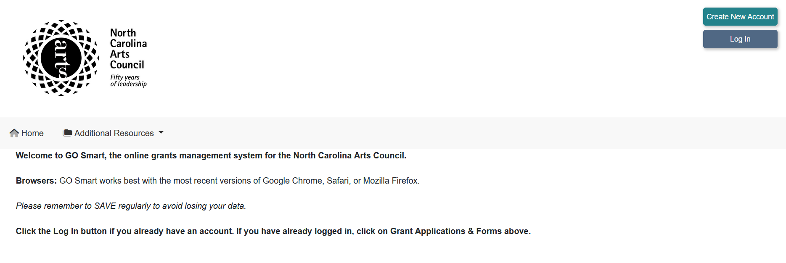
GO Smart grant portal
Go to the GO Smart grant portal at https://ncarts.gosmart.org/ If you do not have an account, create a new one by selecting Create New Account.

Slide 23
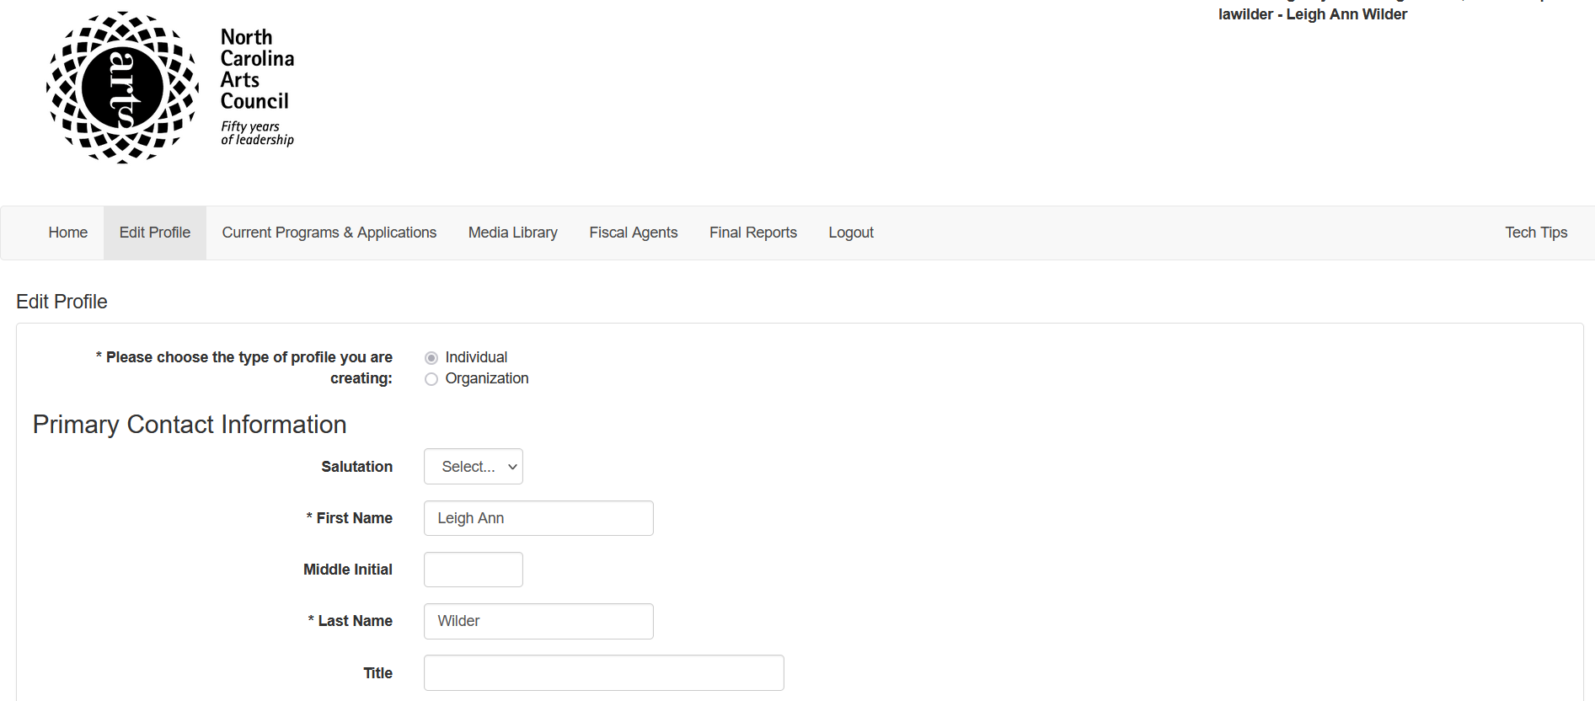
Edit profile
Click on the Edit Profile header near the top of the page to access and complete your applicant profile.

Slide 24
Grant Applications and Forms
2025-26
2025-26
Click on the Grant Applications & Forms header and scroll the available grants to locate the Artist Support Grant 2025-26 grant.

Slide 25
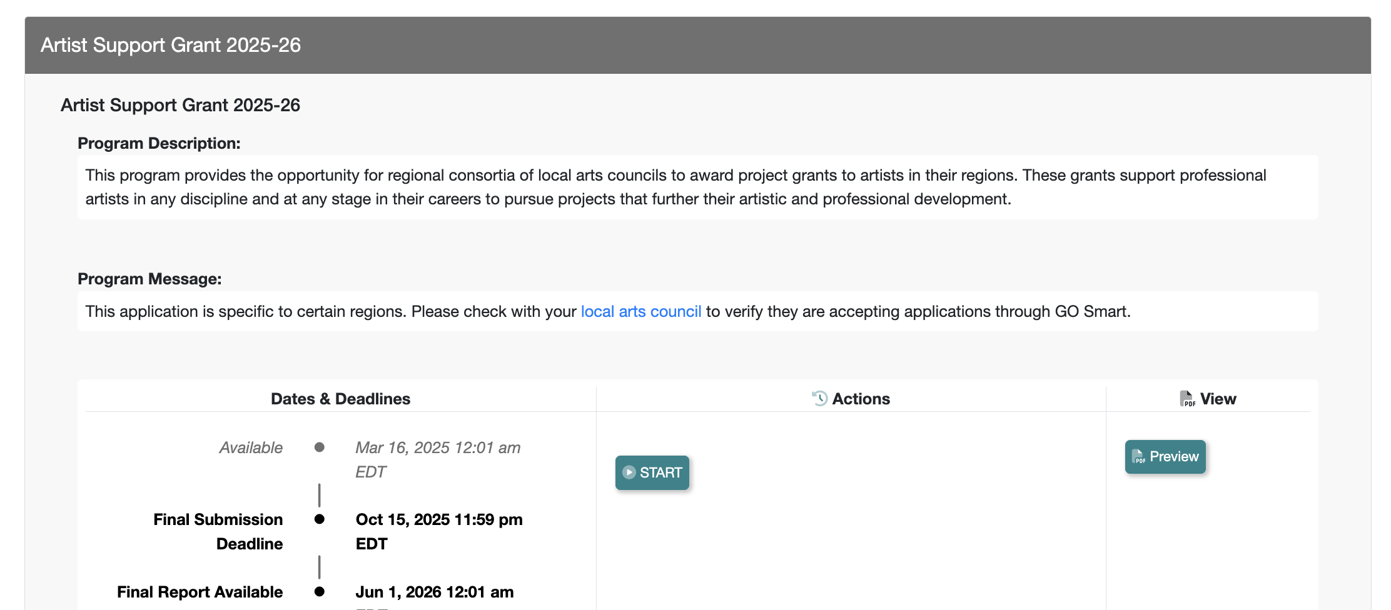
Begin FY 2025-26 Application

Slide 26
Application form – basic information
On the Basic information and narrative questions page of the application, use the dropdown menu to select your region.

Slide 27
Application form – basic information
Use the dropdown menu to select your art discipline.

Slide 28
Application
Project narrative

Slide 29
Project Narrative
Your Project Narrative should explain your proposed project and how it will have an impact on your career as an artist:
Describe your project and the proposed use of funds.
Explain what this project will enable you to do that you are unable to do now.
Summarize how this project will advance your career or development as an artist.

Slide 30
Project Narrative
Your proposal needs to be:
Feasible Don’t propose a project that seems beyond your capacity either in terms of cost, access, or other factors.
A logical step for you It should make sense why the workshop tuition, computer, brochure, or new studio you want would be relevant and helpful to you at this point in your career.
The more specific you can be the better.

Slide 31
Project narrative – general rule of thumb (1/2)
Use simple, declarative sentences in active voice—and get to the point. Observe the space or page limits.
Say what you need to say as efficiently as possible.
Who, what, when, where, why, and how.
If you find, after you’ve answered the application queries, that you haven’t addressed one or more of the questions, you might want to revisit your responses.

Slide 32
Project narrative – general rule of thumb (2/2)
The narrative is not an artist statement.
Keep your answers focused on the practical needs and outcomes of your project.
Ask someone unconnected to the arts to read your application. Their perspective can be valuable in identifying aspects that are unclear or unpersuasive.

Slide 33
Application
Project budget

Slide 34
Project expenses

Slide 35
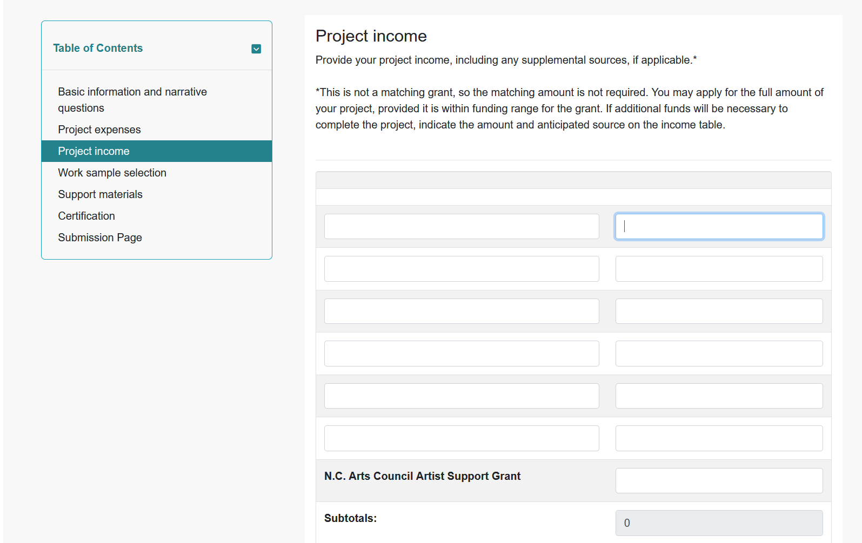
Project income
Supplemental funds
Supplemental Income
Supplemental Income

Slide 36
Project budget tips (1/3)
Provide detail
More detail is better. You can see the difference in the detailed budget on the right:
Example 1
Travel: $600
Example 2
Mileage (200 mi. @ $0.535): $107
Lodging (4 nights @ $85): $340 Meals (5 days @ $35): $175 Total: $622

Slide 37
Project budget tips (2/3)
Provide supporting documentation
Getting an estimate from the provider(s) to support the numbers will result in a stronger application.
For most equipment, airfares, and materials costs, prices can be found online. For professional services, you may need to request an estimate.
Always provide documentation for class, workshop, or conference registration costs.
If studying with a specific teacher is part of your proposal, say why and provide documentation of the teacher’s credibility.

Slide 38
Project budget tips (3/3)
You are not required to spend your own money!
If applicable, show other sources of income.
If you are pursuing or have secured donations from others, especially for more ambitious projects, include that information, as well.
Just leave enough room on the expected income side of your budget to make it clear that you do need the grant.

Slide 39
Application
Work samples

Slide 40
Work sample selection
Be selective about what you include. Choose samples that you consider to be:
Strong and recent representations of the quality of your work.
Cohesive and relevant to the project you have proposed.

Slide 41
Work sample descriptions and labeling
An inventory list should accompany the work samples provided.
The basic information is specific to each discipline. This will be explained in further detail on the next slides.

Slide 42
Dance and performing arts work samples
Documentation of up to three recorded performances. Videos uploaded may not exceed a total time of ten minutes.
Description In the inventory list for work samples, include the date and location of performance, title of piece, names and roles of key people, including directors, choreographers, lead performers/actors, etc. A short summary may also be included.

Slide 43
Music work samples
Documentation of up to three recorded performances. Audio or video uploaded may not exceed a total time of ten minutes.
Description In the inventory list for work samples, include date and location of performance, title of piece, names and roles of key people, including music directors, musician, etc. A short summary may also be included.
Composers and songwriters should also submit scores, lyrics, and/or lead sheets, as appropriate.

Slide 44
Writing work samples
Fiction, creative nonfiction, and playwrights may submit no more than 12 pages each of one to two manuscripts.
Poets may submit five to seven poems.
Playwrights may also submit documentation of a recorded performance or staged reading of their plays (videos, clip not to exceed five minutes.)

Slide 45
Visual art and craft work samples
Up to 15 images of your work.
Images must be high quality – not blurry or pixelated.
Description In the inventory list, include the title, date of completion, medium, and dimensions.

Slide 46
Film work samples
Documentation of one or more completed films.
Video clips not to exceed five minutes.
Description In the inventory list, include date of filming, title of piece, names and roles of key people, including directors, lead performers/actors, etc. A short summary may also be included.

Slide 47
Things to note for audio and video work samples
Due to file sizes, YouTube and Vimeo links are preferred for video.
Please indicate if the work sample is professionally mastered.
Do not upload MP4 files directly to the application.

Slide 48
Work samples
Must be of your work only!
Work must be completed within the past three years.

Slide 49
Application
Support materials

Slide 50
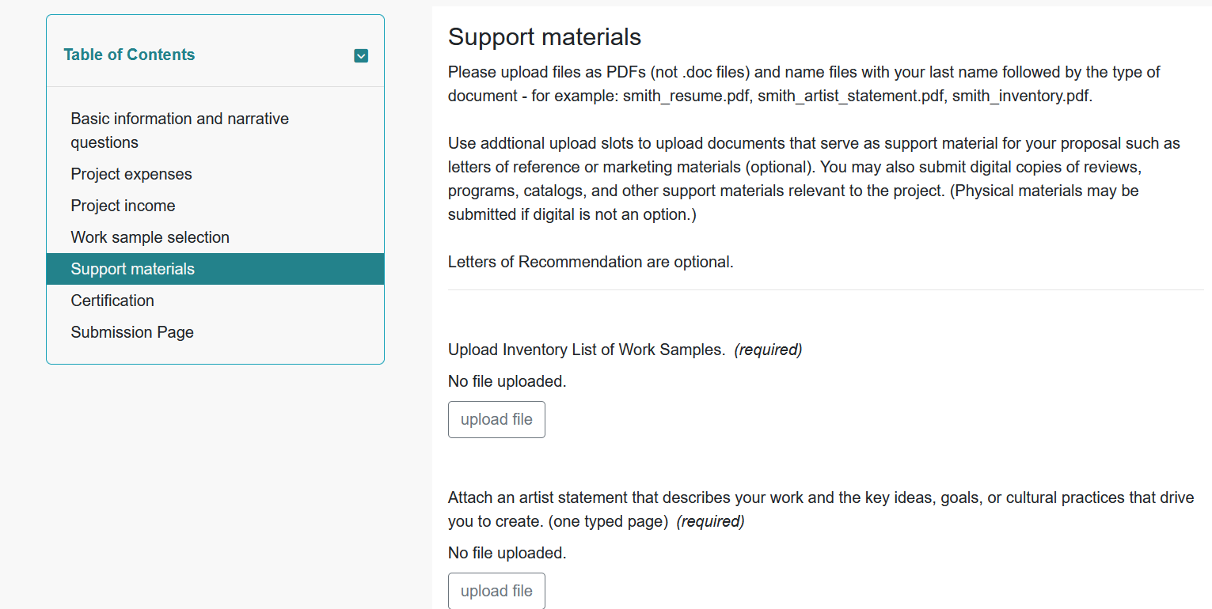
Support materials
Include an inventory list of work samples provided
Include an inventory list of work samples

Slide 51
Support materials – résumés or bios (1/2)
Artist résumés Focus on your activities as an artist, including exhibitions, performances, readings, screenings, commissions, collections that have acquired your work, publishing history, residencies, articles and reviews of your work, workshops taught or taken, lectures, panels, education, employment, awards, etc.
Abbreviated A suggested length is two-to-four pages.

Slide 52
Support materials – résumés or bios (2/2)
If you have limited experience as an artist, foreground your existing artistic achievements in your resume and condense your other work and experience into broad background information.
Use this situation to make the case that the grant is especially important towards making a meaningful step forward in your artistic career.

Slide 53
Letters of Recommendation
Letters of recommendation are optional and should always be the least important part of your proposal.
Have qualified references who can speak specifically and enthusiastically about your abilities as an artist.
Consider the following in choosing references:
First-hand knowledge of your work as an artist
Professional credentials (this is not a personal recommendation)
How recent is the reference’s encounter with your work?

Slide 54
Final steps
Submitting the application

Slide 55
Certify and submit

Slide 56
Review
Application checklist

Slide 57
Application checklist (1/2)
Application profile
Narrative
Artist résumé Attach an artist résumé that includes education, employment, public presentations of your work, publications, commissions, honors, grant or fellowship awards, and relevant experience. (four pages maximum)

Slide 58
Application checklist (2/2)
Budget support Provide support information for your budget, i.e. cost of materials, price quote on services, etc.
Support materials You may submit reviews, programs, catalogs, and other support materials relevant to the project.
Work samples and inventory list

Slide 59
Grantee requirements
If you receive a grant

Slide 60
If you receive a grant
You will enter into a contractual agreement with the lead arts council for your region.
Any promotional and marketing materials for the proposed project must include the N.C. Arts Council logo and credit line.
Funds must be spent by June 30, 2026.
Projects must be completed before December 31, 2026.

Slide 61
Questions?
If you need help with your application or have specific questions, contact:
Leigh Ann Wilder, Senior Program Director, Creative Economies, N.C. Arts Council
Leighann.wilder@dncr.nc.gov

